Slide 1
Mini-Project Review
Name: Rudraksha Ranjan Panda
Reg No.:22BCI0020

Slide 2
Index
Problem Description
Module details and Key features
Design Layout
Sample Code and Screenshots(Appendix)

Slide 3
Problem Description
The current landscape of music streaming platforms presents several challenges for users, including limited personalization, disjointed social features, and a lack of cohesive user experience. Users often struggle to discover new music tailored to their tastes and engage meaningfully with their peers in the digital space.
SpotiClone aims to address these challenges by developing a robust and user-friendly music streaming platform inspired by the success of Spotify. The project seeks to create a seamless and immersive music listening experience that prioritizes personalization, social interaction, and intuitive design.

Slide 4
Module details and Key features
Extensive Catalog: SpotiClone provides an extensive catalog of music across various genres, artists, and albums, catering to diverse musical tastes.
NCS tunes: SpotiClone uses NCS tunes(No Copyright Songs) which helps the user to discover new music and avoids further copyright claims on the website.

Slide 5
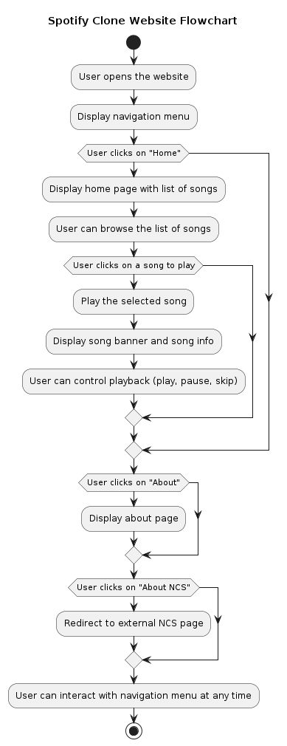
Design(Flowchart)

Slide 6
Appendix
The code has been uploaded in the same drive link.

